Slide 1


A prediction of Oscar winning best songs
Ryan M. Allen
Regis University
Practicum II Capstone Project

Slide 2
An original Dataset
Used Spotify’s R package to scrape song features for all the Oscar’s Best Song Award nominees from 1988 – 2020.
Song features include:
Valence
Instrumentalness
Liveness
Duration
Energy
Tempo
Loudness
Combined with my lyrical sentiment analysis
Total word count
Sentiment score
Notes:
Used Spotify’s API

Slide 3
Sentiment Analysis
Found total word count (minus “stopwords”)for each song
Found an overall sentiment score for each song and year
Using the NRC Emotion Lexicon created a percent column for various emotions
Anger
Trust
Anticipation
Fear

Slide 4
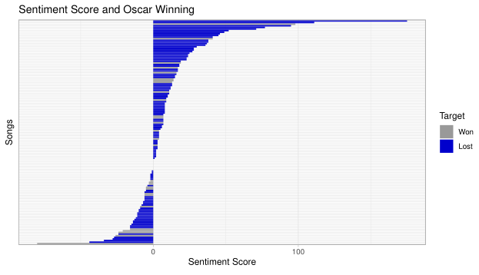
Sentiment Analysis
Notes:
Happy by Pharel in 2013

Slide 5
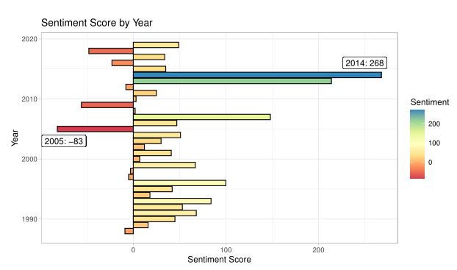
Sentiment Analysis
Notes:
2014 had Everything is Awesome
2005 had Its Hard out for a pimp

Slide 6
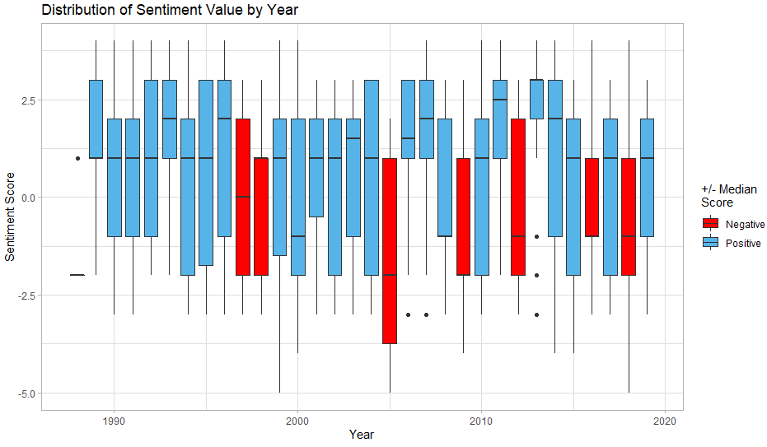
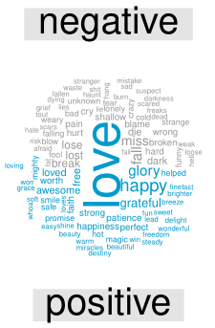
Sentiment Analysis

Slide 7
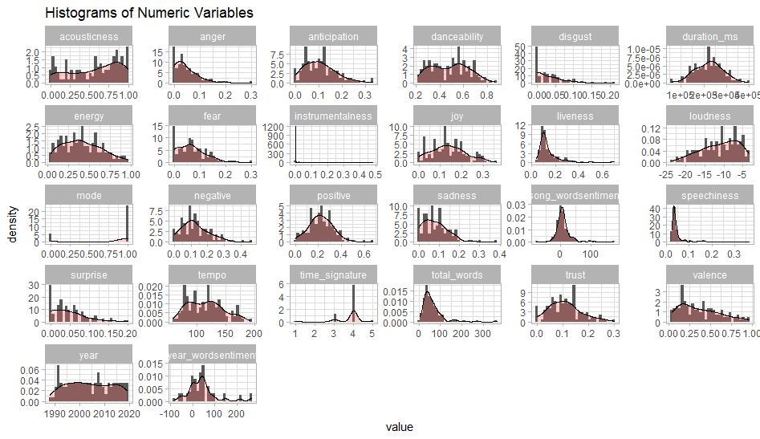
Exploratory Data Analysis

Slide 8
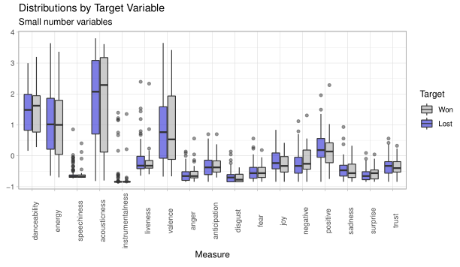
Exploratory Data Analysis
Notes:
Acousticness, danceability, valence, disgust, joy, trust all have seemingly different medians between winning and losing

Slide 9
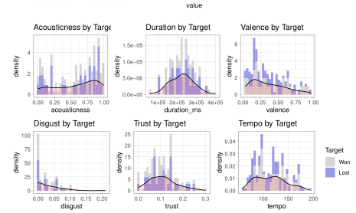
Exploratory Data analysis

Slide 10
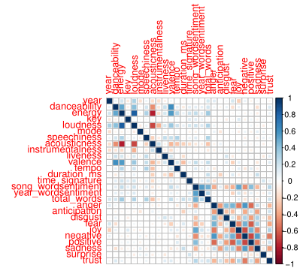
Exploratory Data Analysis
Correlation Plot
We see correlation with many of the fields we would expect.
Also, there seems to be many correlations (+/-) with the lyrical analysis columns.
Notes:
Acousticness negatively with energy and loudness
Positive and Negative
Valence positively with energy and danceability

Slide 11

Predictive Models
Datasets types
Raw Data
Scaled Data
PCA Data
Over/Under/Both/ROSE Sampling
Notes:
ROSE synthetically creates data to maintain the information in the original dataset but still balances the minority variable

Slide 12
Predictive Models
Models
SVM
Regression Trees
LDA (Linear Discriminant Analysis)
Logistic Regression
KNN (k-Nearest Neighbors)
Neural Nets
Notes:
People killed over time is very similar to the extreme attacks over time

Slide 13
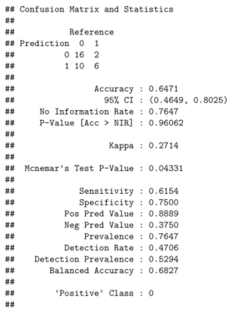
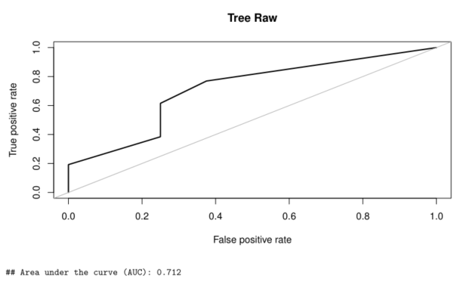
Predictive Models
Regression Trees
Best performance I could get was with the Raw data and with the Tree Over sampled using Scaled data.
Notes:
People killed over time is very similar to the extreme attacks over time

Slide 14
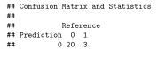
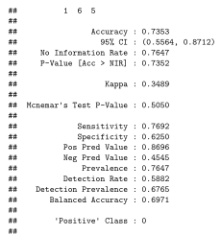
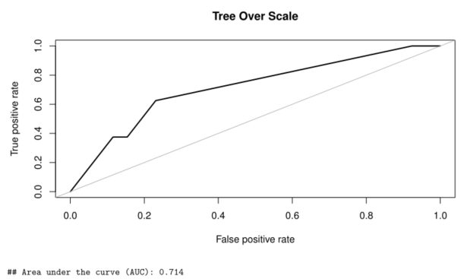
Predictive Models
Regression Trees
Best performance I could get was with the Raw data and with the Tree Over sampled using Scaled data.
Notes:
People killed over time is very similar to the extreme attacks over time

Slide 15
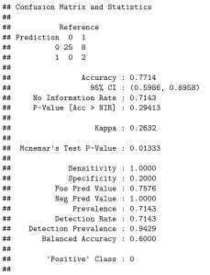
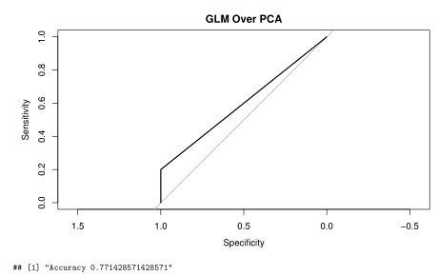
Predictive Models
Logistic Regression
Best performance I could get was with the Over Sampled PCA data.
Notes:
People killed over time is very similar to the extreme attacks over time

Slide 16
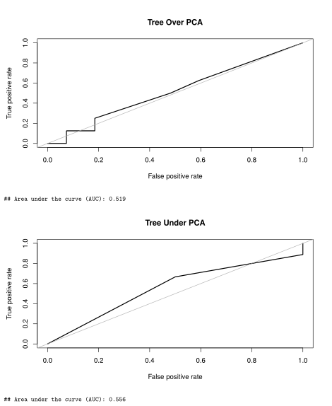
Predictive Models
Other Models Performance
Specificity was an issue all along
Accuracy would be high, but would not beat the No Information Rate
ROC Curves

Slide 17
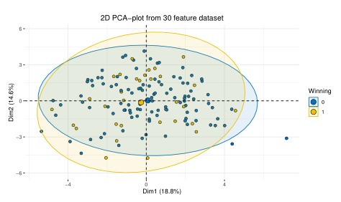
Predictive Models
PCA Plot

Slide 18
Future work and considerations
Emmy Winning
Parameter Tuning
Additional features
Combine Predictions
Notes:
Elliott’s suggestion that Emmy’s would be better, Oscar’s is political
Parameter hyper tuning. I was taken back by the amount of fine tuning that can happen with each model
Additional features – past performance, artist spotify popularity, other musical features (measures, beats, tatums)
Combine predictions – I want to test the hunch out of creating a new column with the prediction from each model and then test one of two things: average predictions between the models I test and take majority rules ( if 3 out of 5 say 1, then it is a 1) or
Use each previous models prediction as a feature in the next models training data? Maybe.

Slide 19
References
Analytics Vidhya. (2016, March 28). Analytics Vidhya. Retrieved from Practical Guide to deal with Imbalanced Classification Problems in R: https://www.analyticsvidhya.com/blog/2016/03/practical-guide-deal-imbalanced-classification-problems/
Bruce, P., & Bruce, A. (2017). Practical Statistics for Data Scientists. Sebastopol, CA: O'Reilly Media, Inc.
McLennan, B. (2018, June 10). Music Lyrical Analysis. Unpacking musical preferences with R. Retrieved from RPubs: https://rpubs.com/BreeMcLennan/music_lyric_analysis
Mohammad, S., & Turney, P. (2013). Crowdsourcing a Word-Emotion Association Lexicon. Computational Intelligence, 29 (3), 436-465.
Nielsen, F. A. (2011, March). A new ANEW: Evaluation of a word list for sentiment analysis in microblogs. Proceedings of the ESWC2011 Workshop on 'Making Sense of Microposts': Big things come in small packages, 93-98. Retrieved from AFINN: https://www2.imm.dtu.dk/pubdb/views/publication_details.php?id=6010
Silge, J., & Robinson, D. (2020). Text Mining with R. O'REILLY.
Spotify. (2020). Spotify for Developers. Retrieved from Web API: https://developer.spotify.com/documentation/web-api/
Notes:
https://rpubs.com/BreeMcLennan/music_lyric_analysis (McLennan, 2018)
https://www.tidytextmining.com/sentiment.html (Silge & Robinson, 2020)
http://www2.imm.dtu.dk/pubdb/views/publication_details.php?id=6010 AFINN reference (Nielsen, 2011)
http://saifmohammad.com/WebPages/NRC-Emotion-Lexicon.htm nrc reference (Mohammad & Turney, 2013)
https://www.analyticsvidhya.com/blog/2016/03/practical-guide-deal-imbalanced-classification-problems/ target imbalance methods in R (Analytics Vidhya, 2016)
(Bruce & Bruce, 2017)
Spotify API

